Slide 1
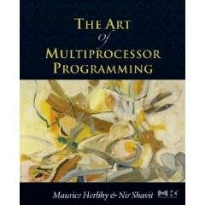
Introduction Parallel and Distributed Computing
Notes:
1

Slide 2
Outline
Concurrency
Parallelism
Distributed systems
Application - peer to peer computing
Race Condition
Mutual exclusion
Hardware and software parallelism
Amdahl’s Law

Slide 3
Concurrency
Concurrency: multiple tasks to be executed in a computer at the same time (concurrent execution)
Example:
Two processes on Two bank accounts

Slide 4
Concurrency
Hardware
Processors
Software
Threads, processes
Sometimes OK to confuse them, sometimes not.
Notes:
4
We will use the terms above, even though there are also terms like strands, CPUs, chips etc also…

Slide 5
Parallel Computing
Parallel computing: is a type of computation in which many calculations or processes are carried out simultaneously.
Large problems can often be divided into smaller ones, which can then be solved at the same time.

Slide 6
Parallel Computing
Using a number of processors to process one task
Speeding up the processing by distributing it to the processors

Slide 7
Why use parallel processing?
Two primary reasons (both performance related)
Faster time to solution (response time)
Solve bigger computing problems (in same time)
Other factors motivate parallel processing
Effective use of machine resources
Cost efficiencies
Overcoming memory constraints
Serial machines have inherent limitations
Processor speed, memory bottlenecks, …
Parallelism = concurrency + parallel HW + performance

Slide 8
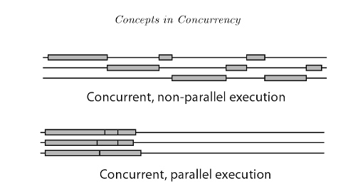
Parallel vs Concurrent

Slide 9
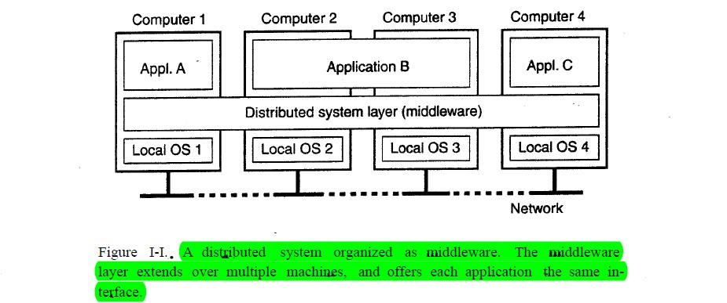
Distributed System
Distributed system
Definition Of A Distributed System: a distributed system is a collection of independent computers that appears to its users as a single coherent system.
Example:
a distributed system organized as middleware. the middleware layer extends over multiple machines , and offers each application the same interface.

Slide 10
Traditional Scaling Process
7x
Speedup
3.6x
1.8x
User code
Traditional
Uniprocessor
Time: Moore’s law
Notes:
10
Recall the traditional scaling process for software: write it once, trust Intel to make the CPU faster to improve performance.

Slide 11
Multicore Scaling Process
7x
3.6x
Speedup
1.8x
User code
Multicore
Unfortunately, not so simple…
Notes:
11
With multicores, we will have to parallelize the code to make software faster, and we cannot do this automatically (except in a limited way on the level of individual instructions).

Slide 12
Real-World Scaling Process
Speedup
2x
2.9x
1.8x
User code
Multicore
Parallelization and Synchronization
require great care…
Notes:
12
This is because splitting the application up to utilize the cores is not simple, and coordination among the various code parts requires care.

Slide 13
Advantages of a distributed system
Transparency
Autonomous
Scalability
Efficiency
Openness
Single Point of Failure

Slide 14
Transparency means keeping the underlying mechanisms hidden so as not to obstruct intended function
Autonomous any technology that can function and execute tasks without being controlled by a human
Scalability the measure of a system's ability to increase or decrease in performance
Efficiency effective operation as measured by a comparison of production with cost (as in energy, time, and money)
Openness An open distributed system is a system that offers services according to standard rules
Single Point of Failure is a part of a system that, if it fails, will stop the entire system from working

Slide 15
Disadvantages of a distributed system
Network is reliable
Network is secure
Network is homogeneous
Topology does not change
Latency is zero
Bandwidth is infinite
Transport cost is zero

Slide 16
Vanishing from your Desktops: The Uniprocesor
cpu
memory
Notes:
16
Traditionally, we have had inexpensive single processor with an associated memory on a chip, which we call a uniprocessor.

Slide 17
Your Server: The Shared Memory Multiprocessor (SMP)
cache
cache
cache
Bus
Bus
shared memory
Notes:
17
And we had expensive multiprocessor chips in the enterprise, that is, in server farms, high performance computing centers and so on. The
Shared memory multiprocessor (SMP) consists of multiple CPUs connected by a bus or interconnect network to a shared memory.

Slide 18
Parallel Architecture & Memory
Share memory
Distributed memory

Slide 19
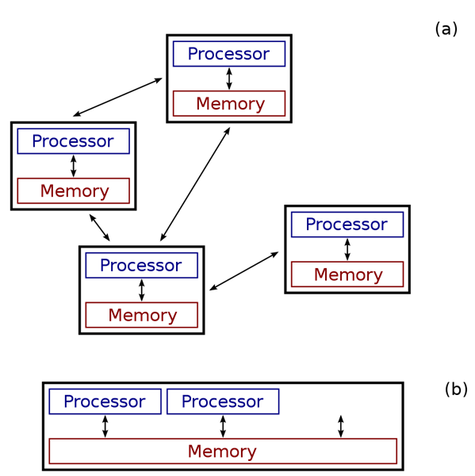

Slide 20
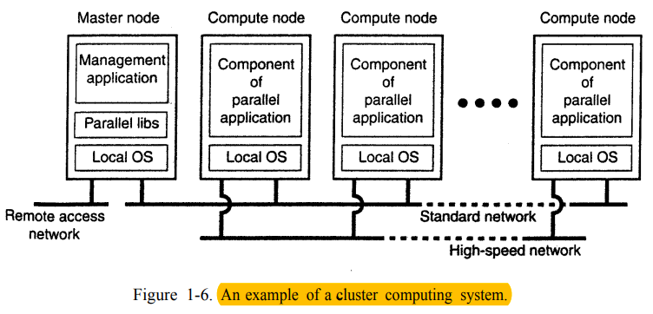
TYPES OF DISTRIBUTED SYSTEMS
1- Cluster Computing Systems : Cluster computing systems has multiple computers and servers connected over network to perform multiple tasks.
associated with homogeneity

Slide 21
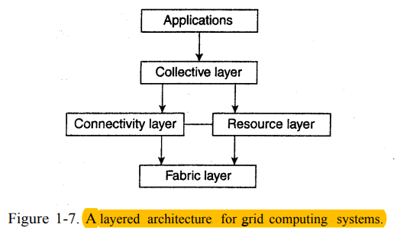
TYPES OF DISTRIBUTED SYSTEMS
2- Grid Computing Systems : has multiple computers and servers connected over network to perform a single task.
associated with homogeneity and heterogeneity

Slide 22
Sensor Networks
sensor networks : sensor monitors data in a different location and sends that data to a central location for storage, viewing, and analysis
Example:
Factories
car sensors
speed radar

Slide 23
The Challenges of Distributed Computing and Performance
A multi-core revolution aims to improve the performance and to exploit the power of concurrent computing, by restructuring applications
Writing concurrent applications is harder than sequential programming because we also need to synchronize memory accesses

Slide 24
Race Condition
1000
Shared memory
Race conditions
$200
$100

Slide 25
Race Condition
1000
Shared memory
1000
1000
$200
$100

Slide 26
Race Condition
1000
Shared memory
1200
1100
$200
$100

Slide 27
Race Condition
1000
Shared memory
1300
1200
1100

Slide 28
Mutual Exclusion
One solution for race condition is to use mutual exclusion.
Mutual exclusion: It is the requirement that one thread of execution never enters a critical section while a concurrent thread of execution is already accessing critical section, which refers to an interval of time during which a thread of execution accesses a shared resource or shared memory.

Slide 29
Mutual Exclusion
1000
Shared memory
Race conditions
+200
+100

Slide 30

Mutual Exclusion
1000
Shared memory
Race conditions
1000
$200
$100
هذه الصورة بواسطة كاتب غير معروف مرخصة بالاسم CC BY-SA-NC

Slide 31
Mutual Exclusion
1000
Shared memory
1100
$200
$100
هذه الصورة بواسطة كاتب غير معروف مرخصة بالاسم CC BY-SA-NC

Slide 32
Mutual Exclusion
1100
Shared memory
1100
$200
$100
هذه الصورة بواسطة كاتب غير معروف مرخصة بالاسم CC BY-SA-NC

Slide 33
Mutual Exclusion
1100
Shared memory
1100
$200
$100
هذه الصورة بواسطة كاتب غير معروف مرخصة بالاسم CC BY-SA-NC

Slide 34
Mutual Exclusion
1100
Shared memory
1100
$200
$100

Slide 35
Mutual Exclusion
1100
Shared memory
1100
1100
$200
$100
هذه الصورة بواسطة كاتب غير معروف مرخصة بالاسم CC BY-SA-NC

Slide 36
Mutual Exclusion
1100
Shared memory
1300
1100
$200
$100
هذه الصورة بواسطة كاتب غير معروف مرخصة بالاسم CC BY-SA-NC

Slide 37
Mutual Exclusion
1300
Shared memory
1300
1100
$200
$100
هذه الصورة بواسطة كاتب غير معروف مرخصة بالاسم CC BY-SA-NC

Slide 38
Mutual Exclusion
1300
Shared memory
1300
1100
$200
$100

Slide 39
Critical section
Mutual exclusion is applied during race condition on critical section.
Critical section: is data that are shared by concurrent processes.

Slide 40
Critical section
Shared memory
10 | W
5 | X
20 | Y
30 | Z
Read X
Add X(20)
Read Y (10)
Read Z
Read W
Add X(10)
Sub Y(10)

Slide 41
Advantages of Parallelism
Speed up and efficiency
Amdahl’s law: this relation is not linear…
Scalability: increase the size of the system/problem
Notes:
41
Mutual exclusion and waiting imply that code is essentially executed sequentially, while one is executing it others spin doing nothing useful. The larger these sequential parts, the worst our utilization of the multiple processors on our machine. Moreover, this relation is not linear: if 25% of the code is sequential, it does not mean that on a ten processor machine we will see a 25% loss of speedup…to understand the real realation, we need to understand
Amdahl’s law. Gene Amdahl was a computer science pioneer.

Slide 42
Hardware Parallelism
Pipeline (self-study)
Instructions

Slide 43
Pipeline Processing
Pipeline processing refers to overlapping operations by moving data or instructions into a conceptual pipe with all stages of the pipe performing simultaneously.

Slide 44
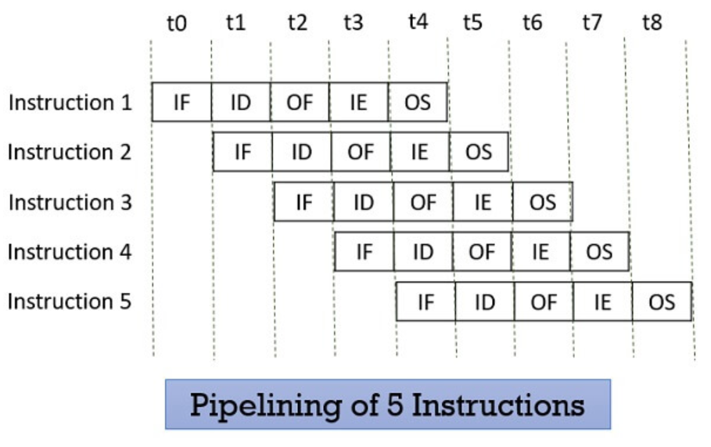
Pipeline Processing

Slide 45
Classifying Parallel Systems – Flynn’s Taxonomy
Distinguishes multi-processor computer architectures along the two independent dimensions
Instruction and Data
Each dimension can have one state: Single or Multiple
SISD: Single Instruction, Single Data
Serial (non-parallel) machine
SIMD: Single Instruction, Multiple Data
Processor arrays and vector machines
MISD: Multiple Instruction, Single Data (weird)
MIMD: Multiple Instruction, Multiple Data
Most common parallel computer systems

Slide 46
Classifying Parallel Systems – Flynn’s Taxonomy
Distinguishes multi-processor computer architectures along the two independent dimensions
Instruction and Data
Each dimension can have one state: Single or Multiple
SISD: Single Instruction, Single Data
Serial (non-parallel) machine
X=10;
Get(x);

Slide 47
Classifying Parallel Systems – Flynn’s Taxonomy
SIMD: Single Instruction, Multiple Data
Processor arrays and vector machines
For (i=0; i<10; i++)
x[i] = x[i] *10;
Divide data among thread/processor and execute in parallel

Slide 48
Classifying Parallel Systems – Flynn’s Taxonomy
MISD: Multiple Instruction, Single Data
Pipeline
Graphics processing Unit GPU
Vector

Slide 49
Classifying Parallel Systems – Flynn’s Taxonomy
MIMD: Multiple Instruction, Multiple Data
Most common parallel computer systems
Bank money transfer transaction

Slide 50
Software parallelism
process
Thread

Slide 51
Process vs Thread
Thread is an execution unit that is part of a process. A process can have multiple threads, all executing at the same time. It is a unit of execution in concurrent programming. A thread is lightweight and can be managed independently by a scheduler. It helps you to improve the application performance using parallelism.

Slide 52
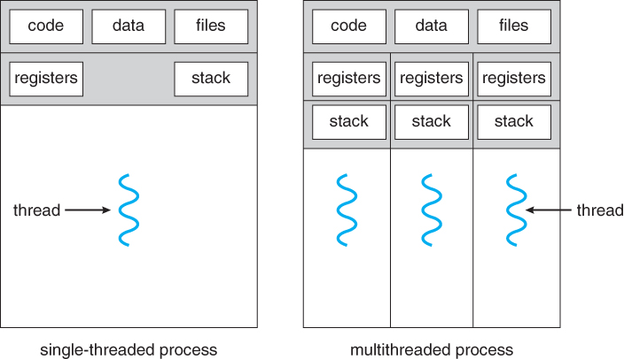
Process vs Thread (tasks)

Slide 53
Multi-threading
Application are classified into:
Fine grained multithreading switches between threads on each instruction, causing the execution of multiple threads to be interleaved.
Coarse grained multithreading switches threads only on costly stalls.
Multi-processors more than one thread run in parallel.

Slide 54
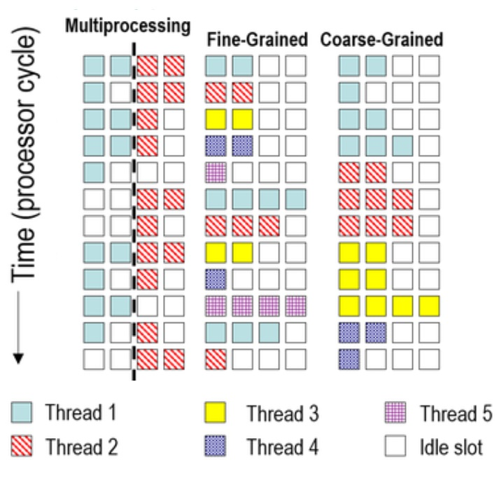

Slide 55
Amdahl’s Law
Speedup=
…of computation given n CPUs instead of 1
Notes:
55
This kind of analysis is very important for concurrent computation.
The formula we need is called \emph{Amdahl's Law}.
It captures the notion that the extent to
which we can speed up any complex job (not just painting)
is limited by how much of the job must be executed sequentially.
Define the \emph{speedup} $S$ of a job to be the ratio between the
time it takes one processor to complete the job (as measured by a wall clock)
versus the time it takes $n$ concurrent processors to complete the same job.
\emph{Amdahl's Law} characterizes the maximum speedup $S$ that can be achieved by $n$
processors collaborating on an application where $p$ is the fraction of
the job that can be executed in parallel.
Assume, for simplicity,
that it takes (normalized) time 1 for a single processor to complete the job.
With $n$ concurrent processors, the parallel part takes time $p/n$ and the sequential part takes time $1-p$.
Overall, the parallelized computation takes time:
$$
1 - p + \frac{p}{n}
$$
Amdahl's Law says that the speedup, that is,
the ratio between the sequential (single-processor) time and the parallel time,
is:
$$
S = \frac{1}{1 - p + \frac{p}{n}}
$$
We show this in the next set of slides

Slide 56
Amdahl’s Law
Speedup=
Notes:
56
AVOID USING THE WORD “CODE”, P is not a fraction of the code but if the execution time of the solution algorithm. It could be that 5% of the code are executed in a loop and account for 90% of the execution time.

Slide 57
Amdahl’s Law
Parallel fraction
Speedup=
Notes:
57

Slide 58
Amdahl’s Law
Sequential fraction
Parallel fraction
Speedup=
Notes:
58

Slide 59
Amdahl’s Law
Sequential fraction
Parallel fraction
Speedup=
Number of processors
Notes:
59

Slide 60
Example
Ten processors
60% concurrent, 40% sequential
How close to 10-fold speedup?
Notes:
60

Slide 61
Example
Ten processors
60% concurrent, 40% sequential
How close to 10-fold speedup?
Speedup = 2.17=
Notes:
61
Explain to students that you work really hard and parallelize 60% of the applications execution (NOT ITS CODE, its EXECUTION)
and get little for your money

Slide 62
Example
Ten processors
80% concurrent, 20% sequential
How close to 10-fold speedup?
Notes:
62

Slide 63
Example
Ten processors
80% concurrent, 20% sequential
How close to 10-fold speedup?
Speedup = 3.57=
Notes:
63
Even with 80% we are only 2/5 utilization, we paid for 10 CPUs and got 4…

Slide 64
Example
Ten processors
90% concurrent, 10% sequential
How close to 10-fold speedup?
Notes:
64
With 90% parallelized we are using only half our computing capacity…

Slide 65
Example
Ten processors
90% concurrent, 10% sequential
How close to 10-fold speedup?
Speedup = 5.26=
Notes:
65
With 99% parallelized we are now utilizing 9 out of 10. What does this say to us?

Slide 66
Example
Ten processors
99% concurrent, 01% sequential
How close to 10-fold speedup?
Notes:
66

Slide 67
Example
Ten processors
99% concurrent, 01% sequential
How close to 10-fold speedup?
Speedup = 9.17=
Notes:
67

Slide 68
Why?
Amdahl’s Law:
Speedup = 1/(ParallelPart/N + SequentialPart)
Pay for N = 8 cores
SequentialPart = 25%
Speedup = only 2.9 times!
As num cores grows the effect of 25% becomes more acute
2.3/4, 2.9/8, 3.4/16, 3.7/32….

